Slide 1

Long Short Term Memory(LSTM)

Slide 2
LSTM
Long Short-Term Memory (LSTM) is an enhanced version of the Recurrent Neural Network (RNN) designed by Hochreiter and Schmidhuber. LSTMs can capture long-term dependencies in sequential data making them ideal for tasks like language translation, speech recognition and time series forecasting.
Unlike traditional RNNs which use a single hidden state passed through time LSTMs introduce a memory cell that holds information over extended periods addressing the challenge of learning long-term dependencies.

Slide 3

Problem with Long-Term Dependencies in RNN
Recurrent Neural Networks (RNNs) are designed to handle sequential data by maintaining a hidden state that captures information from previous time steps. However they often face challenges in learning long-term dependencies where information from distant time steps becomes crucial for making accurate predictions for current state. This problem is known as the vanishing gradient or exploding gradient problem.
Vanishing Gradient
Exploding Gradient

Slide 4
Problem with Long-Term Dependencies in RNN
Vanishing Gradient: When training a model over time, the gradients which help the model learn can shrink as they pass through many steps. This makes it hard for the model to learn long-term patterns since earlier information becomes almost irrelevant.
Exploding Gradient: Sometimes gradients can grow too large causing instability. This makes it difficult for the model to learn properly as the updates to the model become erratic and unpredictable.

Slide 5

LSTM Architecture
LSTM architectures involves the memory cell which is controlled by three gates:
Input gate: Controls what information is added to the memory cell.
Forget gate: Determines what information is removed from the memory cell.
Output gate: Controls what information is output from the memory cell.

Slide 6
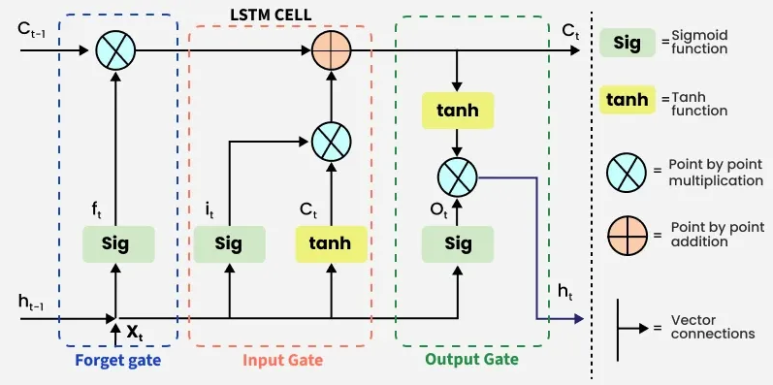
LSTM Working

Slide 7
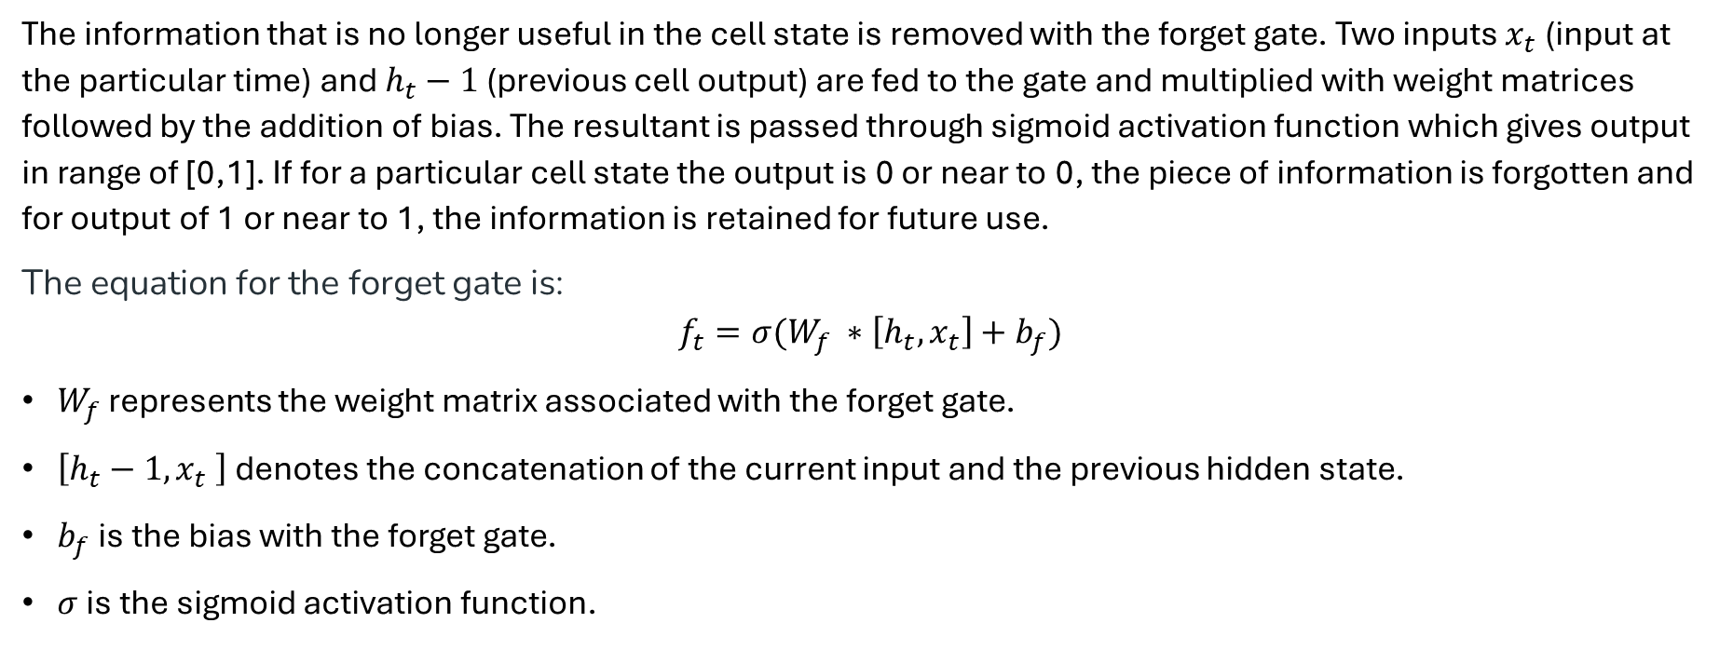
Forget Gate
The information that is no longer useful in the cell state is removed with the forget gate. Two inputs $x_{t}$ (input at the particular time) and $h_{t}−1$ (previous cell output) are fed to the gate and multiplied with weight matrices followed by the addition of bias. The resultant is passed through sigmoid activation function which gives output in range of [0,1]. If for a particular cell state the output is 0 or near to 0, the piece of information is forgotten and for output of 1 or near to 1, the information is retained for future use.
The equation for the forget gate is:
$$f_{t}=σ(W_{f} ∗\left[h_{t},x_{t}\right]+b_{f})$$
$W_{f}$ represents the weight matrix associated with the forget gate.
$\left[h_{t}−1,x_{t} \right]$ denotes the concatenation of the current input and the previous hidden state.
$b_{f}$ is the bias with the forget gate.
$σ$ is the sigmoid activation function.

Slide 8
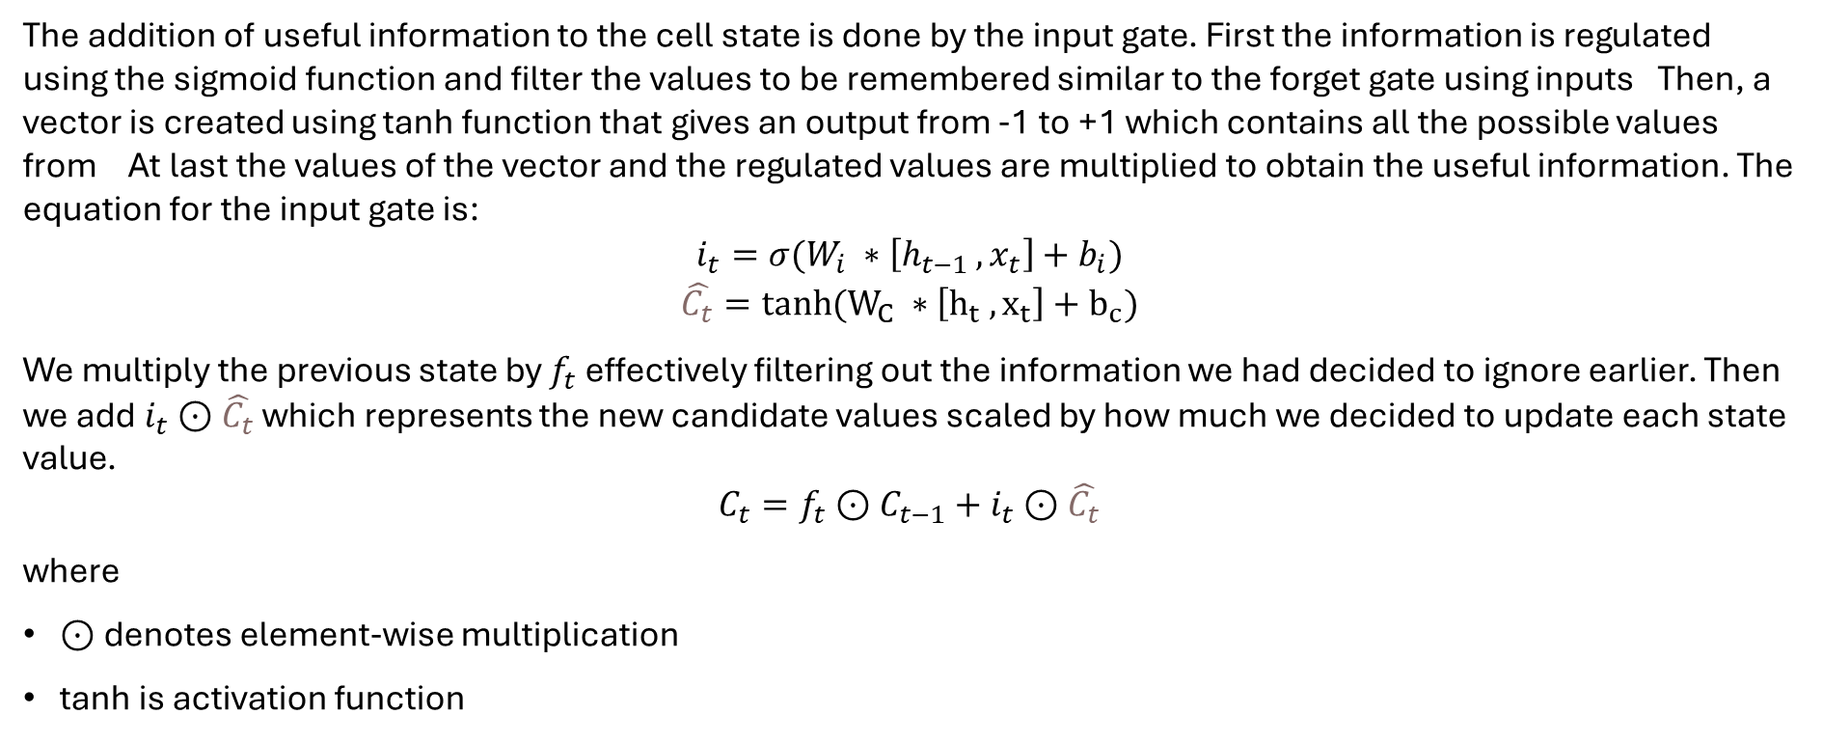
Input gate
The addition of useful information to the cell state is done by the input gate. First the information is regulated using the sigmoid function and filter the values to be remembered similar to the forget gate using inputs Then, a vector is created using tanh function that gives an output from -1 to +1 which contains all the possible values from At last the values of the vector and the regulated values are multiplied to obtain the useful information. The equation for the input gate is:
$$i_{t}=σ(W_{i} ∗\left[h_{t−1 },x_{t}\right]+b_{i})$$
$$\hat{C_{t}}=tanh(W_{C} ∗\left[h_{t} ,x_{t}\right]+b_{c})$$
We multiply the previous state by $f_{t}$ effectively filtering out the information we had decided to ignore earlier. Then we add $i_{t}$ $⊙\hat{C_{t}}$ which represents the new candidate values scaled by how much we decided to update each state value.
$$C_{t}=f_{t}⊙C_{t−1}+i_{t}⊙\hat{C_{t}}$$
where
$⊙$denotes element-wise multiplication
tanh is activation function

Slide 9
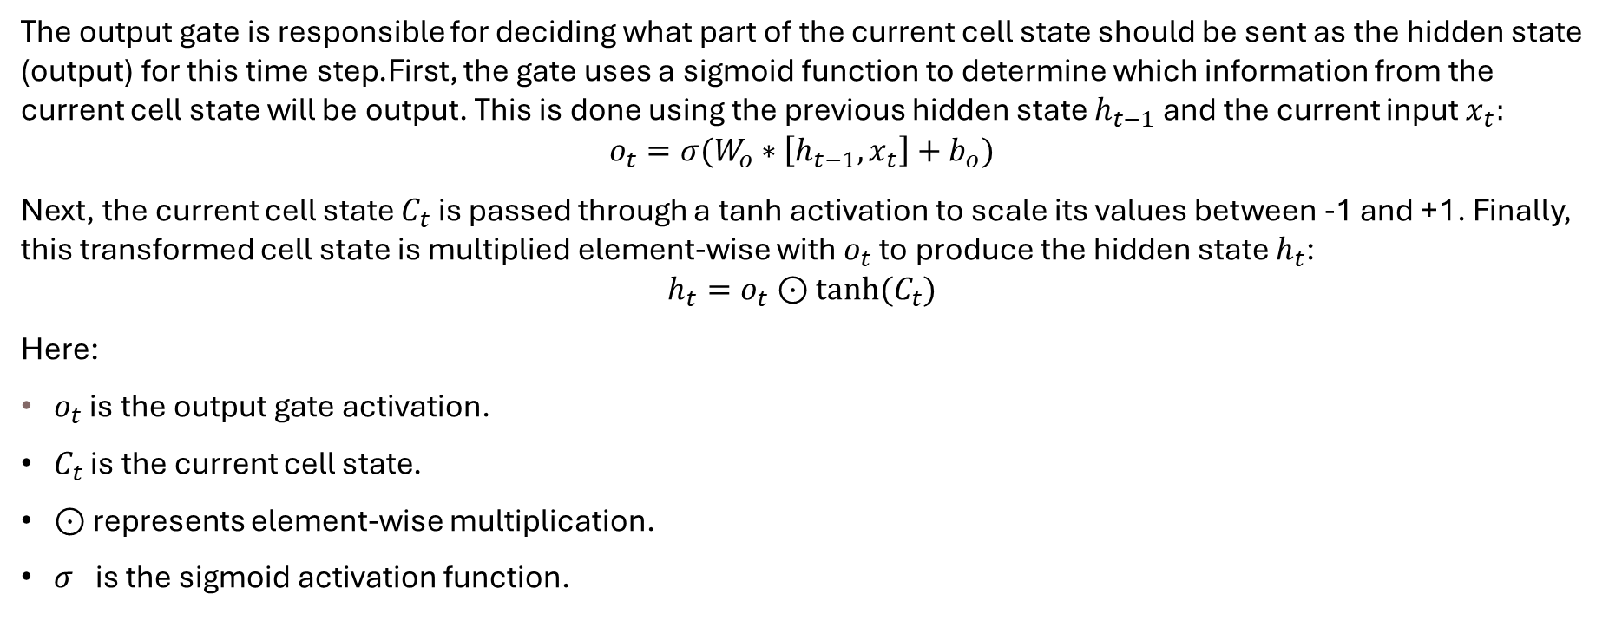
Output gate
The output gate is responsible for deciding what part of the current cell state should be sent as the hidden state (output) for this time step.First, the gate uses a sigmoid function to determine which information from the current cell state will be output. This is done using the previous hidden state $h_{t−1}$ and the current input $x_{t}:$
$$o_{t}=σ(W_{o}∗\left[h_{t−1},x_{t}\right]+b_{o})$$
Next, the current cell state $C_{t}$ is passed through a tanh activation to scale its values between -1 and +1. Finally, this transformed cell state is multiplied element-wise with $o_{t}$ to produce the hidden state $h_{t}$:
$$h_{t}=o_{t}⊙tanh⁡(C_{t})$$
Here:
$o_{t}$ is the output gate activation.
$C_{t}$ is the current cell state.
$⊙$ represents element-wise multiplication.
$σ$is the sigmoid activation function.

Slide 10
Applications of LSTM
Language Modeling
Speech Recognition
Time Series Forecasting
Anomaly Detection
Recommender Systems
Video Analysis

